Slide 1

Community
By Dhatri Bhogadi
Notes:
Your title should let your audience know what the presentation is about.
For 15 seconds or less, consider talking about the assigned region and key issue that you focussed on during your research and let that also reflect in your presentation title.

Slide 2
Contents
What is Community Impact?
About
Featured Influencers
Traits
Learnings & Insights
Conclusion

Slide 3

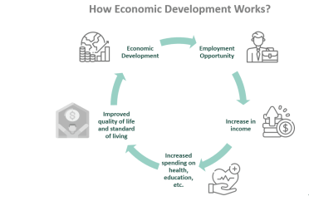

What is Community Impact?
Notes:
6 tips to make a presentation that doesn’t stink:
Draft a basic text outline. Organize. Don’t overthink!
Time your slides. 1 slide = max 60 seconds. This presentation suggests the ideal time to be spent on each slide.
Use meaningful supportive visuals. All design (images/videos/graphics, color, animation) must serve your content. Everything else is just EXTRA! Remember, less is more.
Write clear, concise text. Ideally, a slide should not contain more than 60—100 words. Visuals are the best way to amplify your ideas. Use the screenshots you may have captured during your research. Create images, videos, infographics. Let the audience ‘see’ what you think rather than read it.
Understand your audience. You already know the reason why you’ve created this deck. You’re providing a solution to a business challenge. The other part of the equation is to understand how your audience likes to communicate. How descriptive do they want you to be? How visual do they want you to be?
They want you. You have been chosen for this externship for a reason. Trust yourself, and remember that you’re here to learn. And you learn the most by doing. So get your hands dirty.

Slide 4


About
CSR Europe :
CSR Europe is the leading European business network for Corporate Sustainability and Responsibility. Increase the integration of sustainability into business models and management of companies. Be a platform for collaboration with stakeholders and a catalyst for innovation to build a sustainable and inclusive society in Europe and beyond. Engage with the European institutions about policy to drive the global sustainability agenda.
The Trussell Trust:
The Trussell Trust supports a nationwide network of food banks and together we provide emergency food and support to people locked in poverty, and campaign for change to end the need for food banks in the UK. We recognise that ending hunger is about more than food.They support and encourage their food banks to provide compassionate, practical support to people in crisis to tackle the root causes that lock people into poverty and build people’s resilience so they are less likely to need a food bank in the future.

Slide 5
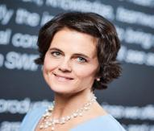
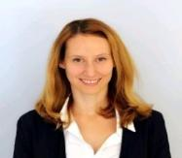
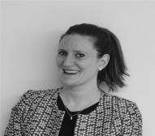
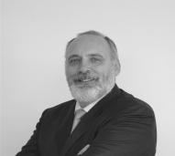
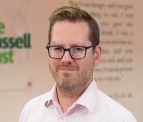
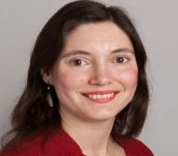

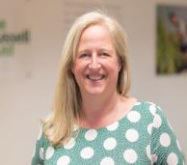
[Featured Policy Influencers]
Katja Mader
(CSR Europe)
Director of People & Organization
Daria Delnevo
(CSR Europe)
Communications & Network Manager
Lorena Sorrentino
(CSR Europe)
Materials manager, Sustainability&Due Diligence
Stefan Crets
(CSR Europe)
Executive Director
Matthew van Duyvenbode
(The Trussell Trust)
Chief Strategy Officer
Helen Barnard
(The Trussell Trust)
Director of Policy, Research and Impact
Nahida Ahmed
(The Trussell Trust)
Director of People and Inclusion
Emma Revie
(The Trussell Trust)
Chief Executive Officer
Notes:
In less than 40 seconds, mention who are the featured policy influencers, and 3-4 common traits that will describe them collectively. These traits should be such that make them seem influential and credible.
Traits would indicate- recurring behavior of any kind
Are they actively engaging on LinkedIn through consistent posting
Are they regularly invited for panel discussions?
Do their values guide their decision on working with different organizations? (work ex history will show if they've consistently work for the same cause.)
So from all the information that you have already collected, what are certain patterns that you observe in the behavior of an individual, and also all the influencers as a group.

Slide 6
Multi-Disciplinary :
Educational background
Tenured,Thoughtful Leaders
Addresses social issues, Theoretical
contributions & Workshops, tenured leaders
Influential:
Social Presence
https://www.linkedin.com/in/katjamader/
(Masters in Commercial Sciences)
University of Bologna, Faculty of Political Sciences "Roberto Ruffilli"
https://www.linkedin.com/in/dariadelnevo/
ASERI, Postgraduate School of Economics and International Relations, Catholic University of the Sacred Heart, Milan, Italy
https://www.linkedin.com/in/lorenasorrentino/
MA in sociology from the University of Antwerp.
https://www.linkedin.com/in/stefan-crets-4837185/
BA in Theology from Durham University
https://www.linkedin.com/in/duyvenbode/
MA Leadership and Management
https://www.linkedin.com/in/nahida-ahmed-a76b7522/
BA (Hons) European Studies and German
https://www.linkedin.com/in/emma-revie-4a970112/
https://www.youtube.com/watch?v=2I2cQJ2fy34
https://www.facebook.com/thebridgebyaltitude/videos/163876242238624/
https://www.researchgate.net/publication/299710852_CSR_Europe_Sustainability_and_Business
JPIT Conference 2022 : https://jpit.uk/conference
https://fairnessfoundation.com/contributors/helen-barnard
https://sites.libsyn.com/451452/what-is-e-d-i-b-a-discussion-on-equity-diversity-inclusion-and-belonging
https://www.youtube.com/watch?v=wiZRXRFShvs
https://www.newstatesman.com/spotlight/economic-growth/cost-of-living-crisis/2023/12/emma-revie-national-housing-crisis-food-banks-homelessness
https://bfi.co.uk/speakers/nahida-ahmed/
https://conservativehome.com/2023/06/30/helen-barnard-reducing-the-demand-for-government-4-families-giving-them-the-help-they-need-to-thrive/
Compass Study Day 2018 : https://carmelitenuns.uk/compass-study-day-2018/
https://www.researchgate.net/publication/299710852_CSR_Europe_Sustainability_and_Business
https://ideas.repec.org/a/kap/jbuset/v185y2023i3d10.1007_s10551-022-05183-1.html
Notes:
In 60 seconds or under, expand on 3-4 common traits by citing evidence on what these influencers have done (work experience, educational background). Screenshots, quotes, links to body of work/interviews et al. would all count as evidence for the traits.

Slide 7
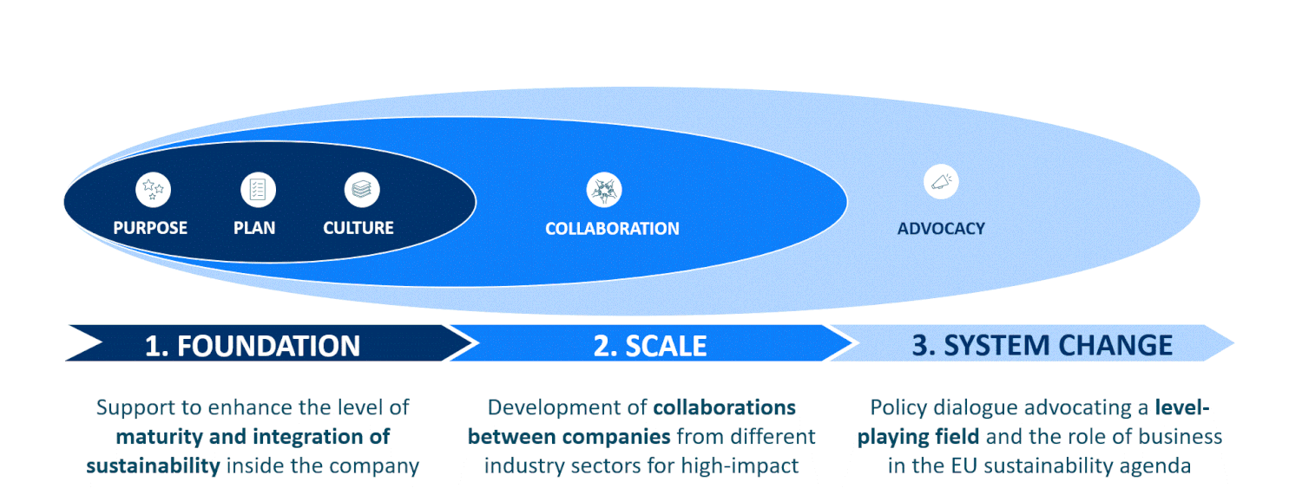
Learnings
CSR Europe
Source:https://static1.squarespace.com/static/5df776f6866c14507f2df68a/t/65241667e982036140f99728/1696863854970/Drive+Sustainability+Progress+Report_Online+version_FINAL_29-09-2023.pdf

Slide 8
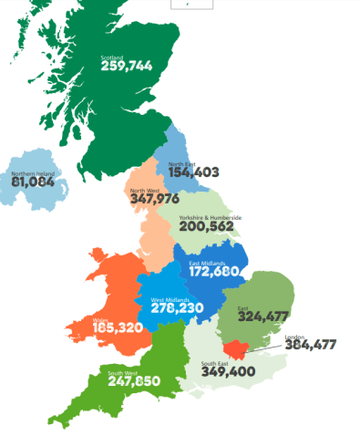
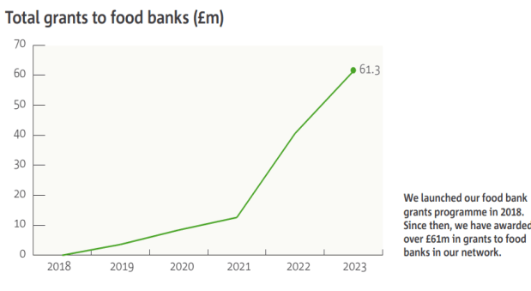
Insights
The Trussell Trust
Source:https://www.trusselltrust.org/wp-content/uploads/sites/2/2024/01/trussell_trust_annual_report_2022-23.pdf

Slide 9
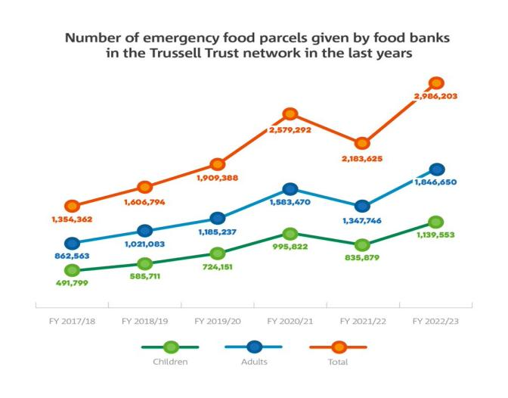
Insights
Source:https://www.trusselltrust.org/wp-content/uploads/sites/2/2024/01/trussell_trust_annual_report_2022-23.pdf

Slide 10
[Conclusion]
Hence, from the learnings and insights, I can conclude that both the organizations exemplify a commitment to Social responsibility and sustainability.
While CSR europe focuses on promoting sustainable business and policy advocacy at a broader level, The Trussell Trust addresses immediate needs and works towards long-term solutions to alleviate poverty and insecurity within local communities.
Notes:
Expand on how these 3-4 common traits are meaningful to influence the conversations and initiatives for the key issues.

Slide 11

Thank you

